Slide 2
THE DISCIPLES RELATIONSHIP:
TO HIMSELF
An Athlete
A Soldier
TO HIS LORD
The Potter and the Clay
The Vine and the Branches
A Child of God
TO HIS BRETHREN
A Member of the Body
“My Brother’s Keeper”
A Servant
TO THE WORLD
Strangers & Pilgrims
Salt & Light
An Apologist
Fishers of Men

Slide 3
THE DISCIPLES RELATIONSHIP TO THE WORLD:
Strangers & Pilgrims
We are different from the world
Salt & Light
We are an influence in the world
An Apologist
We are ready to explain our hope with the world
Fishers of Men
We are working to help those lost in the world

Slide 4
LESSON 12: An Apologist The Disciple’s Answer
But sanctify the Lord God in your hearts, and always be ready to give a defense to everyone who asks you a reason for the hope that is in you, with meekness and fear; (1 Peter 3:15)

Slide 5
An Apologist – Lesson 12
An Apologist
Sanctify the Lord God in Your Hearts
Always Ready
To Give a Defense
To Everyone Who Ask
A Reason For the Hope That is in You
With the Proper Attitude
Meekness
Fear
A Good Conscience

Slide 6
Salt and Light – Lesson 11
Salt
A Preservative
Salt Gives Flavor
Salt Creates Thirst
Light
Light Reveals and Illuminates
Light Drives Away Darkness
Light Gives Guidance
Light Warms and Comforts
Light Draws Those Out of the Darkness
Maintaining Our Influence

Slide 7
An Apologist
Defense – Greek “apologian”→ English “apology”
It does not mean Christians “apologize” for our faith
It does mean Christians “give a defense” for our faith
Christian Apologetics – is a branch of Christian theology that defends Christianity against objections, or defends the evidence that supports Christianity

Slide 8
An Apologist
Paul was appointed for the defense of the Gospel (Phil 1:16)
Acts 17:2-3
And according to Paul's custom, he went to them, and for three Sabbaths reasoned with them from the Scriptures, explaining and giving evidence that the Christ had to suffer and rise again from the dead, and saying, "This Jesus whom I am proclaiming to you is the Christ."

Slide 9
An Apologist
Was this just for the Apostles?
Jude 3
Beloved, while I was making every effort to write you about our common salvation, I felt the necessity to write to you appealing that you contend earnestly for the faith which was once for all handed down to the saints.
Contend – fight
Earnestly - agonize

Slide 10
An Apologist
Do disciples really need to be ready today?
No Trials
No Persecution
No Prison
When and with whom might we have to defend the gospel?
Atheist
False Teacher/Doctrine
Worldly Views

Slide 11
Sanctify the Lord God in Your Hearts
KJV & NKJV – “the Lord God” - Newer but less manuscripts
NASB and others – “Christ as Lord” - Older but fewer manuscripts
Sanctify as Lord– Set Apart as Master, set above all else
The definition of a Disciple
Heart – Center of the Physical and Spiritual Life

Slide 12
Sanctify the Lord God in Your Hearts
If God or Christ is Lord in our hearts what are the results in our lives?
… obedience
… no fear of others (Heb 13:6)
… look to Him for approval
… want to please Him
… confidence in Him (Heb 4:14-16)
… defend Him
… others will notice our actions and responses

Slide 13
Always Be Ready
We are not inspired like the Apostles, so how do we get ready?
(2 Timothy 2:15) Be diligent to present yourself approved to God as a workman who does not need to be ashamed, accurately handling the word of truth.
Heb 5:12-14

Slide 14
Always Be Ready
Things a disciple can do to be Ready
Read and Study the Bible
Know why you obeyed – what scriptures
Know why we do what we do
Sing
Pray
Lords Supper weekly
Assemble with Saints
Attend Classes
Attend every Assembly
Read Debates
Don’t argue men’s arguments - Scripture
Takes Time and Effort

Slide 15
Always Be Ready
How are these efforts helpful?
Rom 10:17 – Strengthens or Faith → Confidence
Eph 4:11-15
(Phil 1:14) and that most of the brethren, trusting in the Lord because of my imprisonment, have far more courage to speak the word of God without fear.
How does this help those who are lost?

Slide 16
To Give a Defense
Greek “Apologian” – to give a formal defense
Disciples must be ready to give a reasoned intelligent explanation for their faith.
Where does this reasoned intelligent explanation come from?
The Word of God-what better response could there be?
Why not your own ideas, opinions or personal experiences?
Being ready is not good enough, you must actually give a defense when the time comes.

Slide 17
To Give a Defense
What about…?
“Well, I think…”
“My Preacher says…”
“Our church believes…”
(John 17:17) "Sanctify them in the truth; Your word is truth.
The only adequate defense is the Word of God properly used.
Takes Time and Effort

Slide 18
To Everyone Who Asks You
“Always” – unceasingly
Who’s “everyone who asks you”?
What if you are busy and don’t have the time?
Getting ready for a big presentation at work?
You someplace you have to be?
What if they have been mean to you in the past?
Made you look bad to coworkers or boss?
They are a mean boss?
They are a mean nosy neighbor?
Pray for these opportunities, they are the best ones.

Slide 19
To Everyone Who Asks You
When it does not mean “everyone”…
1 Tim 6:3-5, 2 Tim 2:16-18, Tit 3:9-11, Matt7:6
These situations require wisdom…
…but don’t use them as an excuse not to teach someone.
How do you know if they fit this category if you do not have at least one conversation?

Slide 20
A Reason for the Hope that is in You
How do they know there is a hope within you?
(1 Peter 2:12) Keep your behavior excellent among the Gentiles, so that in the thing in which they slander you as evildoers, they may because of your good deeds, as they observe them, glorify God in the day of visitation.
Are you ready to explain these?
Why you have hope in your trials Why we do not fear death
The existence of God Why we take the Lord’s Supper every Sunday
The existence of Heaven and Hell The inspiration of the Bible
The deity of Christ Why we do not use instrumental music
The validity of His resurrection Why we reject denominationalism
What one must do to be saved The purpose and method of baptism
Heb 5:12-6:2

Slide 21
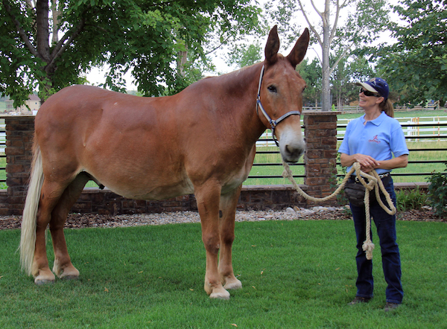
With Meekness and Fear
Meekness
The classical Greek word used to translate meekness was that for a horse that had been tamed and bridled
(Eph 4:15) but speaking the truth in love, we are to grow up in all aspects into Him who is the head, even Christ,
(Col 4:5-6) Conduct yourselves with wisdom toward outsiders, making the most of the opportunity. Let your speech always be with grace, as though seasoned with salt, so that you will know how you should respond to each person.
Face to Face preferred to over written (email, txt, FB, …)

Slide 22
With Meekness and Fear
Fear (Reverence)
Why fear when we give an answer?
“Except by the grace of God there go I”
The source of our answers reflects the reverence we have for God’s word and commandments.
Do others see this reverence, or do they see how “smart” we are?
(1 Cor 2:1-2) And when I came to you, brethren, I did not come with superiority of speech or of wisdom, proclaiming to you the testimony of God. For I determined to know nothing among you except Jesus Christ, and Him crucified.

Slide 23
A Good Conscience
(1 Peter 3:15-16) but sanctify Christ as Lord in your hearts, always being ready to make a defense to everyone who asks you to give an account for the hope that is in you, yet with gentleness and reverence; and keep a good conscience so that in the thing in which you are slandered, those who revile your good behavior in Christ will be put to shame.
Hypocrisy has a devastating effect on our influence

Slide 24
An Apologist
Have you sanctified Christ as Master in your Physical and Spiritual Life?
Are you Ready to give a defense?
Do others see the hope that is in you?
Can you answer in meekness and fear?
Would you be viewed as a hypocrite?

